Slide 1
Motion detect processor
Dang Le Dinh Trang

Slide 2
System diagram
FPGA (DE2-115)
PC
(Qt app on Ubuntu)
UART
UART
Controller
I2C controller
SPI master controller
I2C
SPI
MPR121
ADS1292

Slide 3
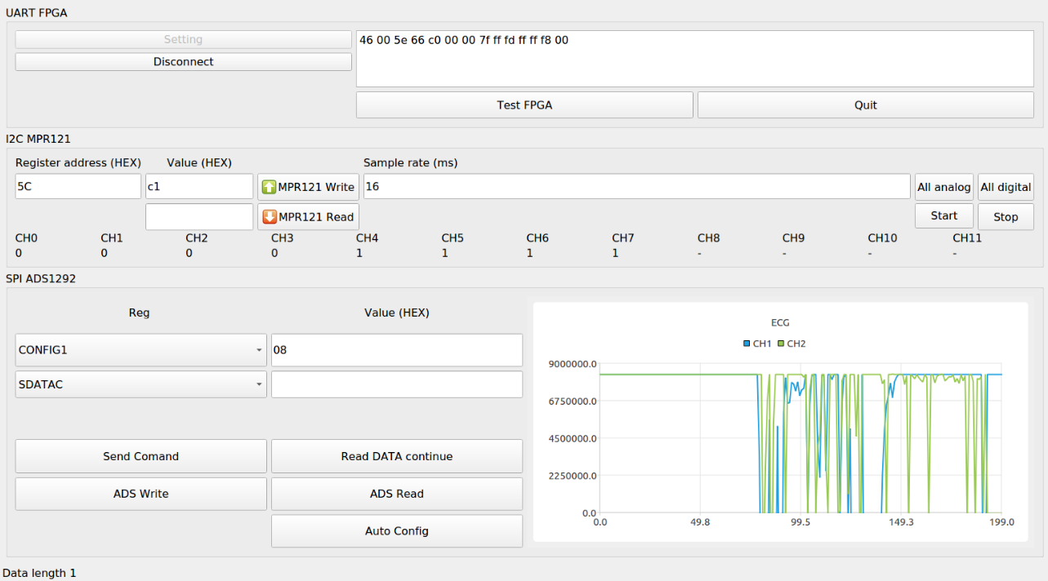
PC app
OS: Ubuntu/Window
Dev platform: Qt
Features for MPR:
Read/write registers
Auto read touch results
Features for ADS:
Send system command
Receive and show ECG data stream continue

Slide 4
UART
Console
Close program
Test connection between PC and FPGA. If connection is ok, console will show “54 54 54 …”

Slide 5
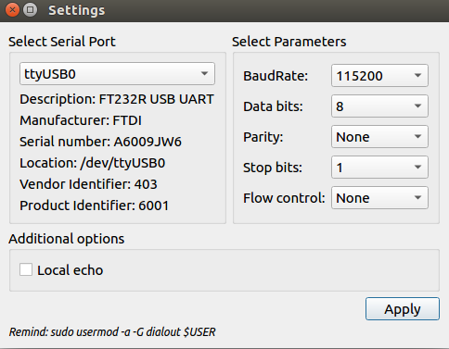
Connect with FPGA by serial port
Click to “Setting” of UART fpga
Select serial port
Baudrate = 115200
Apply
Then click to Connect on mainwindow

Slide 6
MPR121 control
Written value
Register address
Read/write register
Touch results of 12 channel
1 is touched
0 is none
Start sensing
Stop sensing

Slide 7
MPR121 testing
Connect FPGA via UART
Click Start for start sensing
Click Stop for stop sensing
For individual configure or access any MPR’s register, read/write with address and a value
MPR121 | DE2-115
IRQ | GPIO_23
SCL | GPIO_22
SDA | GPIO_25
ADDR | GPIO_24
GND | GND
VIN | 5V

Slide 8
ADS1292
select register
select system command
Value for write into reg
ECG waveform (raw data)

Slide 9
ADS1292 testing
After connect PC
Click Auto config
Click Read data continue for start measurement and receive ECG data
Click ADS read or Auto config for stop
ADS1292 | DE2-115
VCC | 3.3V
SPI_CLK | GPIO_17
SPI_MISO | GPIO_14
SPI_MOSI | GPIO_15
DRDY | GPIO_12
RESET | GPIO_13
START | GPIO_10
SPI_CSN | GPIO_11
DGND | GND

Slide 10
Source code
FPGA code: khu_sensor.tar.gz
PC app source code: khu_sensor_test.tar.gz

